Slide 1
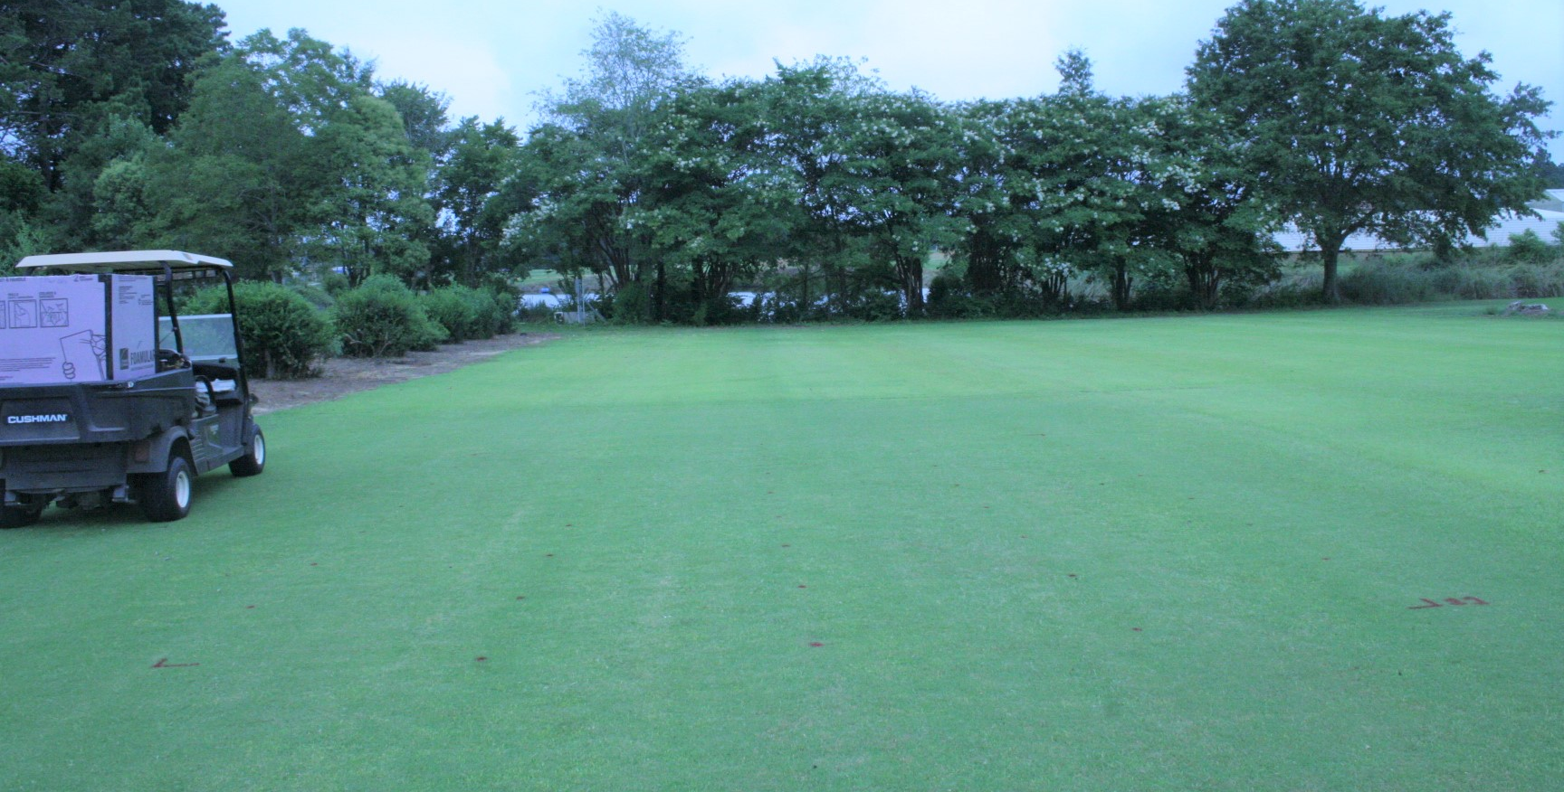


Remote Sensing and Biological Fungicides to Enhance Rhizoctonia Control of Warm Season Turfgrasses in Georgia
Bahri Bahri, Alfredo Martinez, James Buck
University of Georgia-Griffin Campus

Slide 2
Remote Sensing and Biological Fungicides to Enhance Rhizoctonia Control of Warm Season Turfgrasses in Georgia
2 years of funding from GGEF; Total amount: $19,950.00
Objectives:
1) Remote sensing of R. solani infection
2) Investigate the potential use of biofungicides to reduce R. solani in vitro
3) Evaluate the efficacy of biofungicides for the control of Rhizoctonia larch patch in zoysiagrass in growth chamber trials
4) Evaluate the efficacy of biofungicides for the control of Rhizoctonia large patch in zoysiagrass in field trials

Slide 3
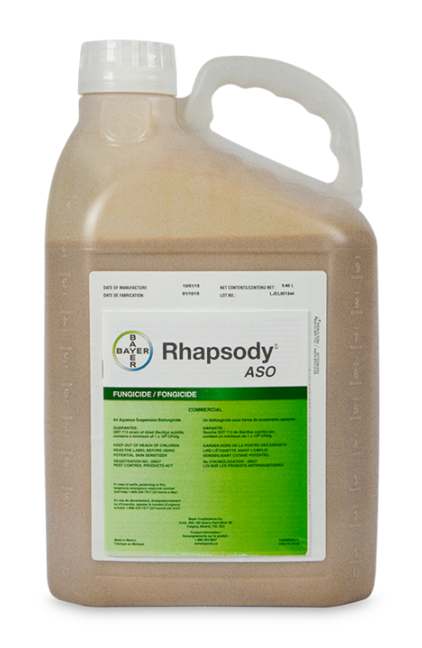
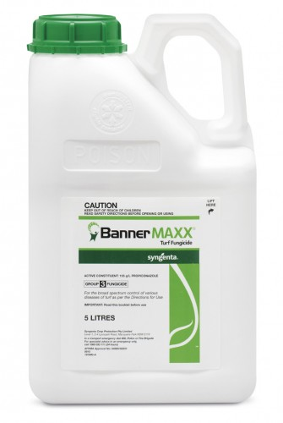
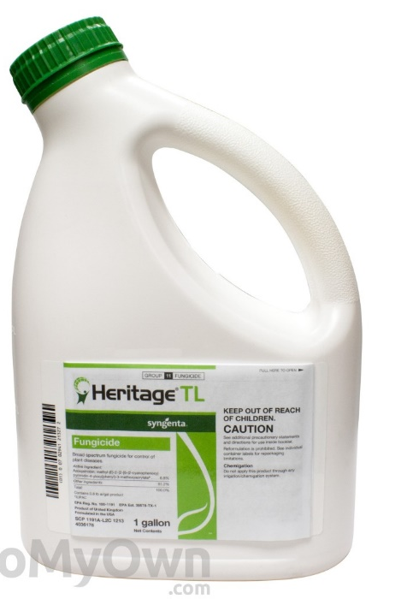
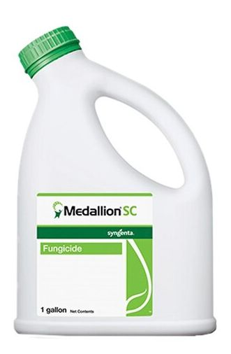
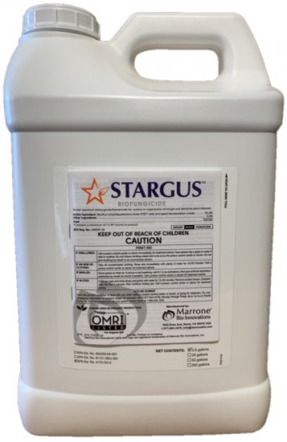
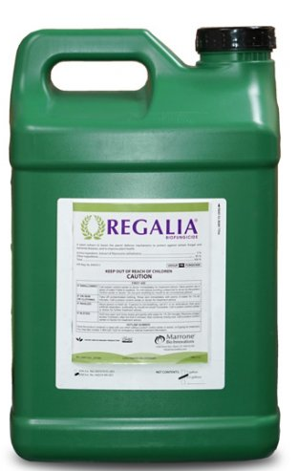
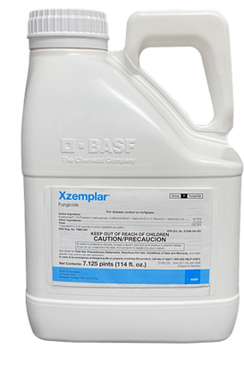
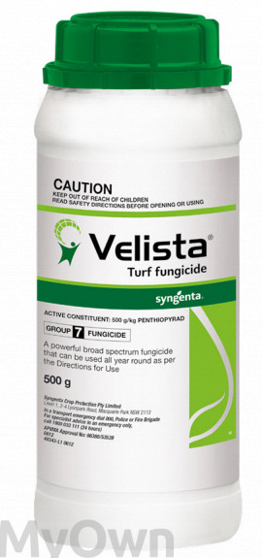
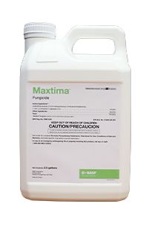
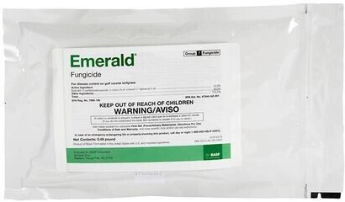
Biofungicide efficacy assay against Rhizoctonia solani in vitro
Biofungicides
Synthetic fungicides
10 combinations of bio- and synthetic fungicides (B. subtilis QST713, R. sachalinensis extr., and propiconazole) at varying label rates (25:75%, 50:50%, and 75:25%)
B. amyloliquefaciens F727
B. subtilis QST713
Propiconazole
Azoxystrobin
Fludioxonil
R. sachalinensis extr.
Mefentrifluconazole
Fluxapyroxad
Penthiopyrad
Boscalid
Notes:
Rationale to our study: The widespread occurrence of fungicide-resistant isolates causing large patch indicates that synthetic fungicides should be applied judiciously and the incorporation of bio-fungicides in the spray program could curtail the excess load of chemicals.
First, three biofungicides and seven synthetic fungicides were tested stand-alone in vitro (petri plate)
Then, 10 different combinations of two bio- (B. subtilis QST713 and R. sachalinensis extr) and seven synthetic fungicides at different label rates were tested in vitro
Then, the best 2 products from in vitro trials were tested across seven spray programs in the field
Reynoutria sachalinensis: herbaceous perennial plant; It's extract elicits SA-dependent defense responses against several fungal pathogens including Clarireedia spp.
DMI: propiconazole; QoI: Azoxystrobin; phenylpyrrole (PP): Fludioxonil; SDHI: Fluxapyraoxad, penthiopyrad, boscalid

Slide 4
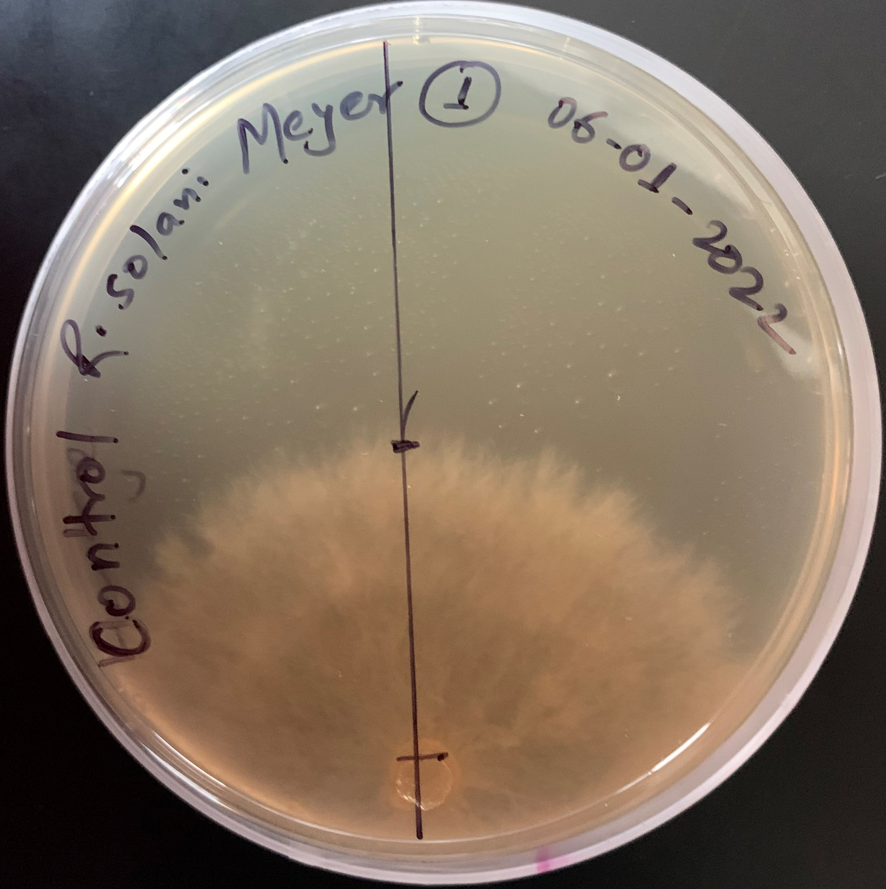
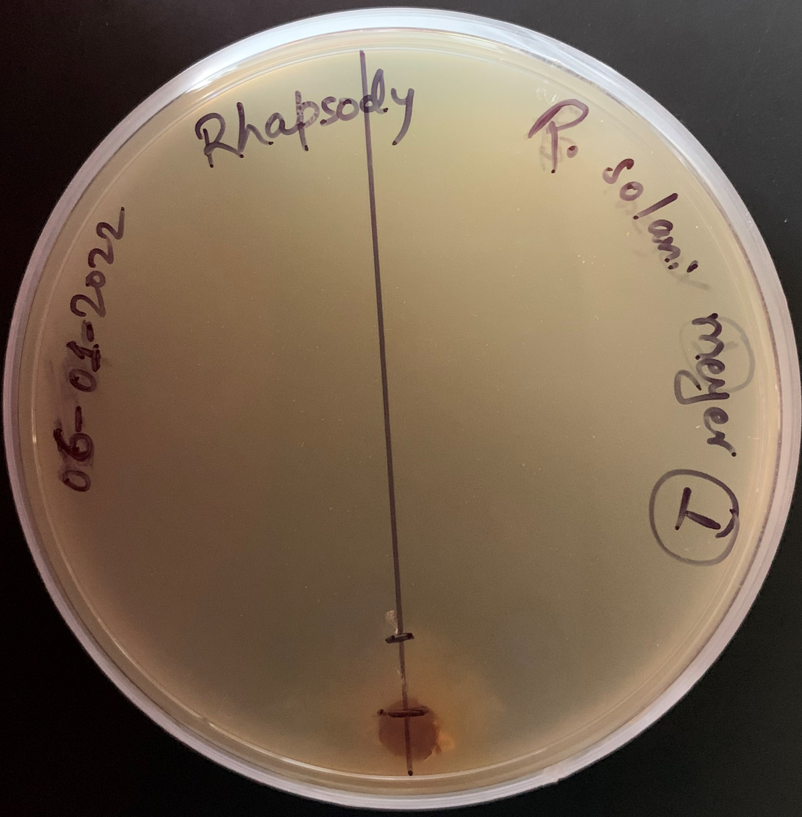
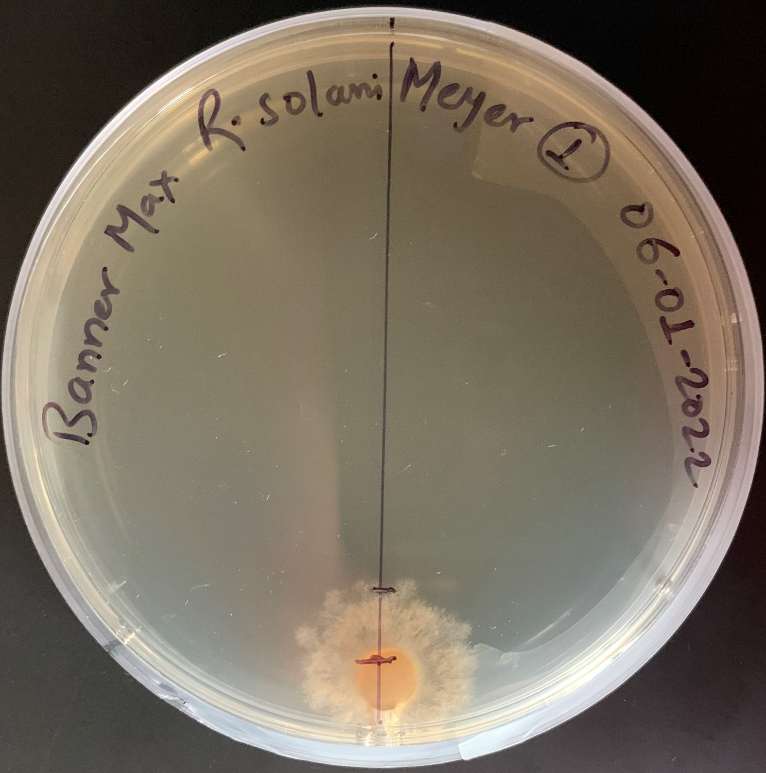
Biofungicide efficacy assay against Rhizoctonia solani in vitro
3 biofungicides and 7 synthetic fungicides tested
10 combinations of bio- and synthetic fungicides tested
Prop. = propiconazole
Bs =
B. subtilis QST713
Ba =
B. amyloliquefaciens F727
Rs =
R. sachalinensis extr.
Control
B. subtilis QST713
Propiconazole
Notes:
Fludioxonil, B. subtilis QST713, Flucapyroxad, and Penthiopyrad were found efficient; however, they were not widely used in turf being expensive, and issues with patent from the manufacturer (Fig. Panel A)
Therefore, propiconazole, which has been out of the patent and was found very efficacious in previous studies, was used in the combination assay along with two other bio-fungicides (Fig. Panel B)
A combination of 75% B. subtilis + 25% propiconazole which used the least amount of synthetic and higher amount of bio-fungicide was further tested in the growth chamber and field experiments.

Slide 5
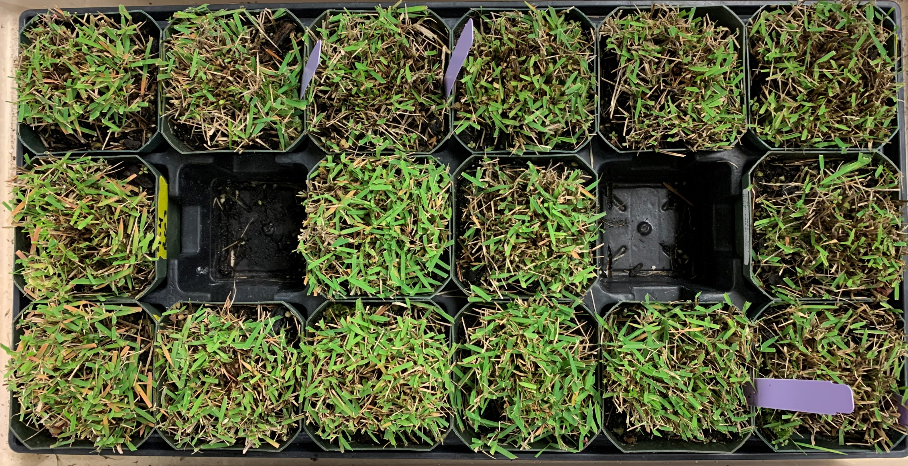
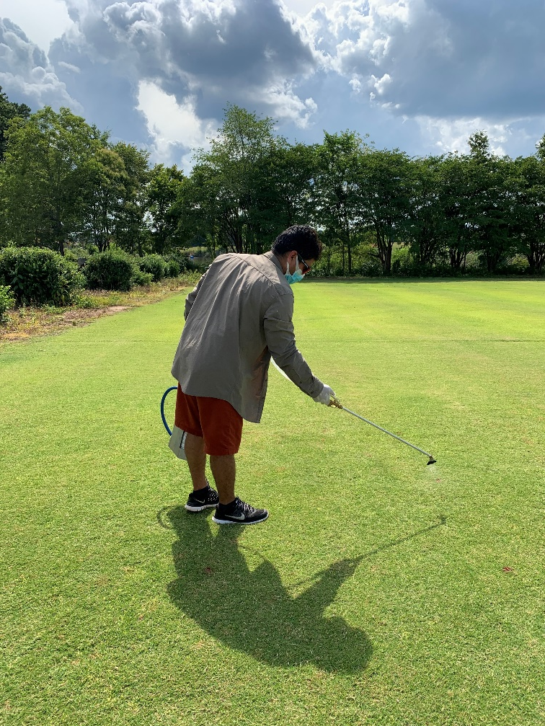
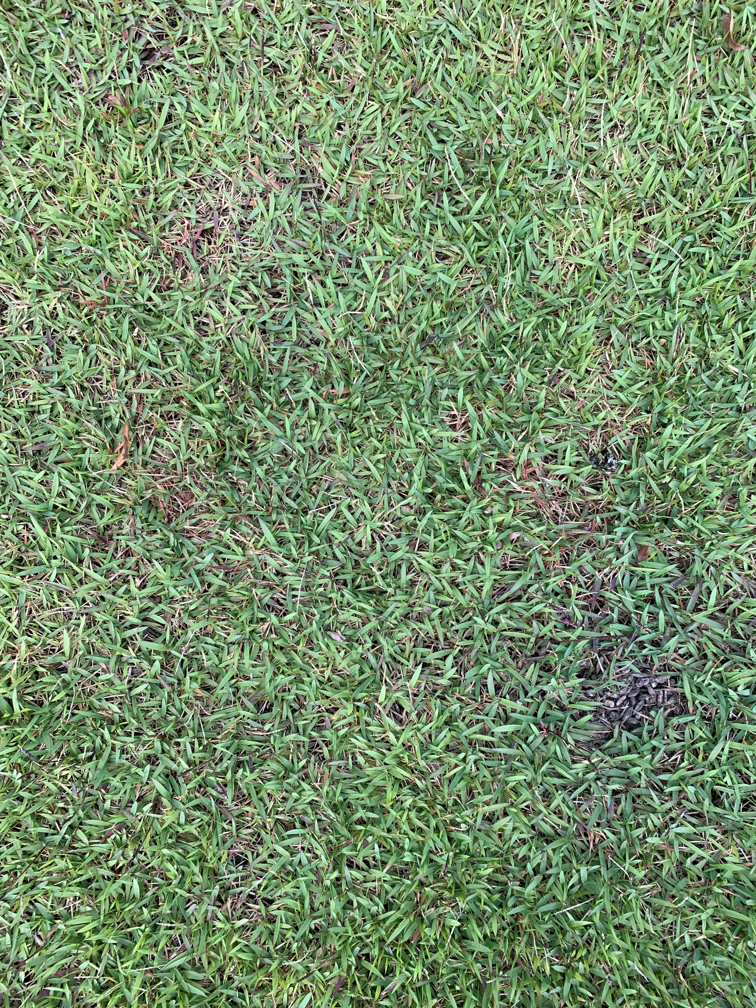
Biofungicide efficacy assay against Rhizoctonia large patch in growth chamber and field trials
Turf type: Zoysiagrass ‘El Toro’
RCBD with four reps
Seven spray programs included (curatively):
Data collected: disease severity (H-B, 1-11 and converted to %; weekly until 42 days), AUDPC, and turf quality (1-9) (only in field study)
T1: NTC with no fungicide
T2: B. subtilis QST713 (Bs) every 7 days
T3: Bs every 14 days
T4: Prop. every 28 days
T5: tank mix of 75% Bs + 25% prop. every 28 days
T6: 75% Bs + 25% prop. tank mix in rotation with 100% Bs every 14 days
T7: 100% Bs in rotation with 75% Bs + 25% prop. tank mix every 14 days
Notes:
Seven spray programs were tested at UGA Griffin campus against RLP on El Toro in the field (during 2 seasons) and in growth chambers (2 experiments)

Slide 6

Biofungicide efficacy assay against Rhizoctonia large patch in growth chamber and field trials
A
B
T1: non-treated control (NTC)
T2: B. subtilis QST713 (Bs)@7 days
T3: Bs@14 days
T4: Prop.@28 days
T5: 75% Bs + 25% prop@28 days
T6: 75% Bs + 25% prop. - 100% Bs@14 days
T7: 100% Bs - 75% Bs + 25% prop.@14 days
Growth chamber
C
D
E
Field
Notes:
Growth chamber experiment showed T6 and T7 as the most effective fungicide spray programs, while T4 performed the best in the field experiments.
Therefore, spray programs comprising a tank mix of B. subtilis QST713 and propiconazole in rotation with biofungicide B. subtilis QST713 every 14 days (both T6 and T7) is recommended to control large patch from this study. This spray program was either equally efficacious as standalone propiconazole or even outcompeted propiconazole in the growth chamber study (based on AUDPC), thereby suppressing large patch disease severity by 75 and 51% in growth chamber and field experiments, respectively.

Slide 7
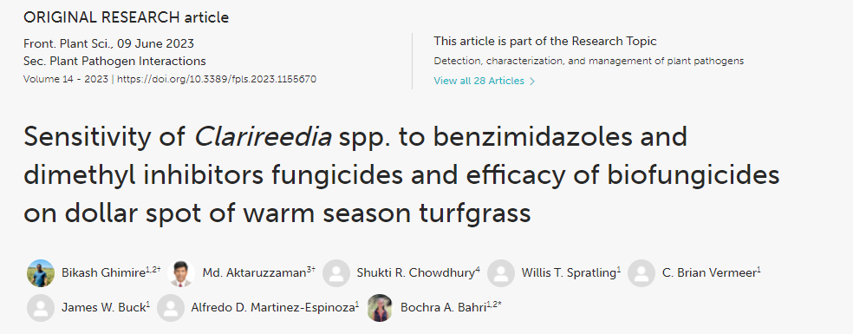
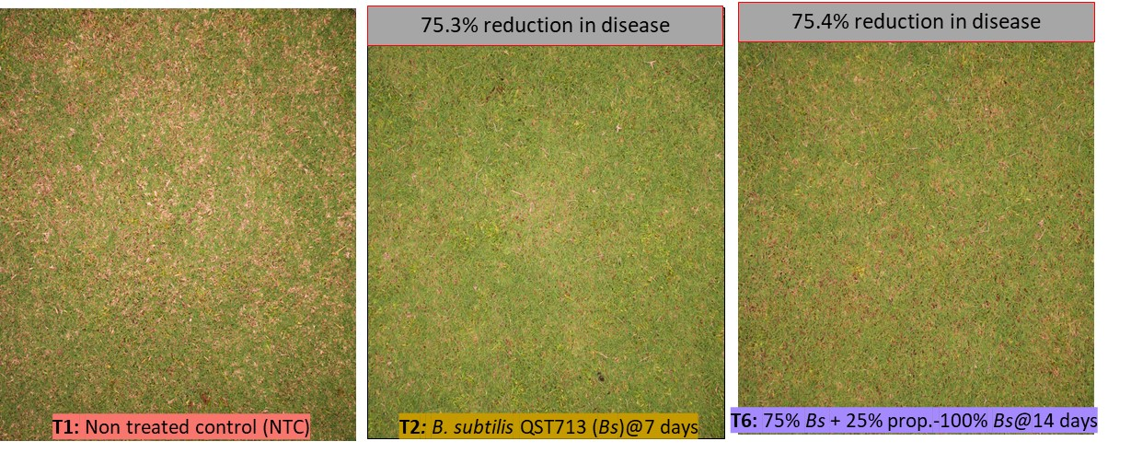
Biofungicide efficacy assay against dollar spot in field trials
T1: NTC
T2: B. subtilis QST713 (Bs)@7 days
T3: Bs@14 days
T4: Prop.@28 days
T5: 75% Bs + 25% prop@28 days
T6: 75% Bs + 25% prop. - 100% Bs@14 days
T7: 100% Bs - 75% Bs + 25% prop.@14 days
Notes:
A similar in vitro, growth chamber and field work was done against Dollar spot on Bermuda grass ‘TifTuf’ at UGA Griffin Campus. Here we are reporting the field results. For more information please refer to our results recently published in Frontiers in Plant Sciences.
Growth chamber experiment showed T5 and T7 as the best, while field experiments showed T2 and T6 as the most effective fungicide spray programs.
With no synthetic fungicide included, B. subtilis QST713 every 7 days (T2) is considered the most effective program which is equally efficacious as propiconazole, suppressing dollar spot severity by 34 and 75% in growth chamber and field experiments, respectively.
Therefore, the use of biofungicides in rotation and/or tank mixed with synthetic fungicides holds promise and homeowners and golf course superintendents could formulate biofungicide inclusive integrated disease management strategies.

Slide 8
Biofungicide efficacy assay against Rhizoctonia large patch_ onsite trial at the Rivermont Golf Club
A
B
C
T1: non-treated control (NTC)
T2: B. subtilis QST713 (Bs)@7 days
T5: 75% Bs + 25% prop@28 days
Collaborator: Mark Hoban_ Rivermont Golf Club
Notes:
An experiment was carried out in the Rivermont Golf Club taking T1, T2, and T5 treatments.
We choose to work on these treatments T2 and T5 because they were the best in controlling dollar spot in the field (Results were recently published in Frontiers in Plant Sciences)
Thanks to the golf club superintendent Mark Hoban for his kind facilitation in conducting the experiment.
T2 was found the best spray program (65% reduction in disease severity), indicating the efficacy of biofungicide B. subtilis QST713 to control large patch on the golf course.

Slide 9
Take Home Message
Use of biofungicides in rotation and/or tank mixed with synthetic fungicides holds promise => Integrated disease management strategies
Biofungicides could be equally efficacious as standalone synthetic fungicides or even outcompeted fungicides (propiconazole)
Rhizoctonia large patch: Tank mix of B. subtilis QST713 and propiconazole in rotation with biofungicide B. subtilis QST713 every 14 days is recommended
Suppress the disease severity by 75 and 51% in growth chamber and field experiments, respectively.
Dollar Spot: B. subtilis QST713 every 7 days is considered the most effective program
Suppress the disease severity by 34 and 75% in growth chamber and field experiments, respectively.

