Slide 1
The Use of Microbial Inoculants to Improve Abiotic Stress Tolerance in Warm and Cool-Season Turfgrasses
David Jespersen and Mussie Habteselassie
University of Georgia – Griffin
November 2023

Slide 2
Introduction
There is a need to improve abiotic stress tolerance of turf areas while simultaneous a desire to reduce chemical inputs
Microbial products are one potential avenue to improving plant performance and soil health
Previous research indicates that BioEnsure (Fungal endophyte) or BioTango (Bacterial suspension) may be able to improve plant stress tolerance
There is a need for robust and objective testing of product prior to widespread recommendation.

Slide 3
Objectives
Testing of products in controlled environments for improvement of
  Heat tolerance in creeping bentgrass
  Drought tolerance in bermudagrass and zoysiagrass
Testing of products in field conditions to determine if similar effects are found in real world conditions for both
  Heat tolerance and summer performance in creeping bentgrass
  Improved drought performance on ultradwarf bermudagrass.
Understanding mechanisms responsible for improved stress tolerance including
  changes in plant physiology and
  microbial composition and function

Slide 4
Objectives
Testing of products in controlled environments for improvement of
  Heat tolerance in creeping bentgrass
  Drought tolerance in bermudagrass and zoysiagrass
Testing of products in field conditions to determine if similar effects are found in real world conditions for both
  Heat tolerance and summer performance in creeping bentgrass
  Improved drought performance on ultradwarf bermudagrass.
Understanding mechanisms responsible for improved stress tolerance including
  changes in plant physiology and
  microbial composition and function
Completed

Slide 5
Objectives
Testing of products in controlled environments for improvement of
  Heat tolerance in creeping bentgrass
  Drought tolerance in bermudagrass and zoysiagrass
Testing of products in field conditions to determine if similar effects are found in real world conditions for both
  Heat tolerance and summer performance in creeping bentgrass
  Improved drought performance on ultradwarf bermudagrass.
Understanding mechanisms responsible for improved stress tolerance including
  changes in plant physiology and
  microbial composition and function
Ongoing
Completed
Ongoing

Slide 6
Timeline
Funding letter – April, 2023
Field Trials initiated – June, 2023
Field Trials concluded [analysis ongoing] – September, 2023
Controlled environment plants established – October, 2023
Controlled environment Trials – Winter 2023
Final Report – April, 2024

Slide 7
Preliminary Results - Bermudagrass
Source Nparm DFNum DFDen F Ratio Prob > F
Treat 3 3 91.3 0.2376558 0.8699
Date 7 7 89.3 33.698645 <.0001*
Treat*Date 21 21 89.3 1.2570846 0.2267
Source Nparm DFNum DFDen F Ratio Prob > F
Treat 3 3 103.1 0.7829727 0.5061
Date 8 8 101.2 88.447301 <.0001*
Treat*Date 24 24 101.2 0.6160746 0.9131

Slide 8
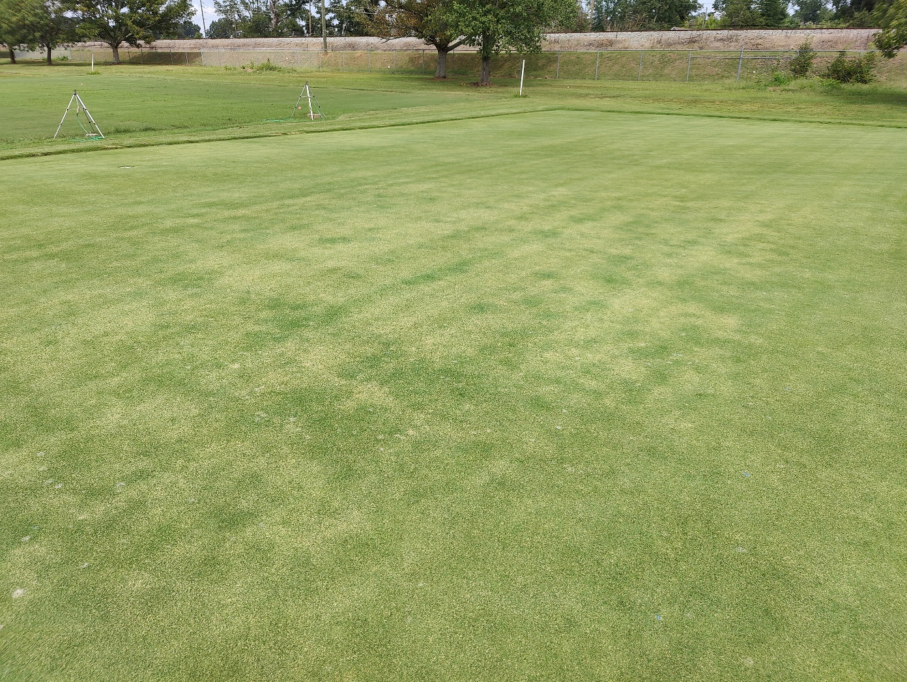
Drought symptom on bermudagrass

Slide 9
Preliminary Results - Bentgrass
Source Nparm DFNum DFDen F Ratio Prob > F
Treat 3 3 73.0 0.0410205 0.9888
Date 6 6 73.2 21.853883 <.0001*
Treat*Date 18 18 73.0 0.5117157 0.9443
Source Nparm DFNum DFDen F Ratio Prob > F
Treat 3 3 93.0 0.3300067 0.8037
Date 7 7 93.0 37.196464 <.0001*
Treat*Date 21 21 93.0 0.6806387 0.8419

Slide 10
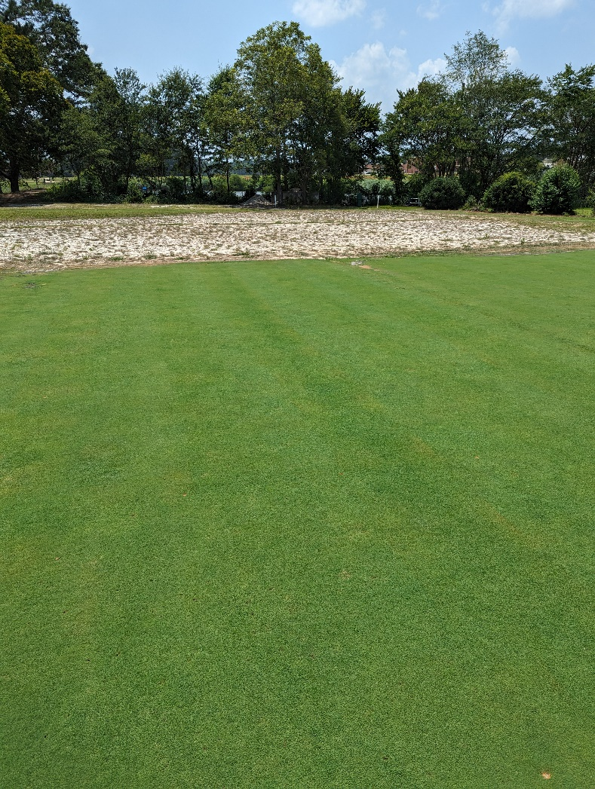
Bentgrass trial – July 20th

Slide 11
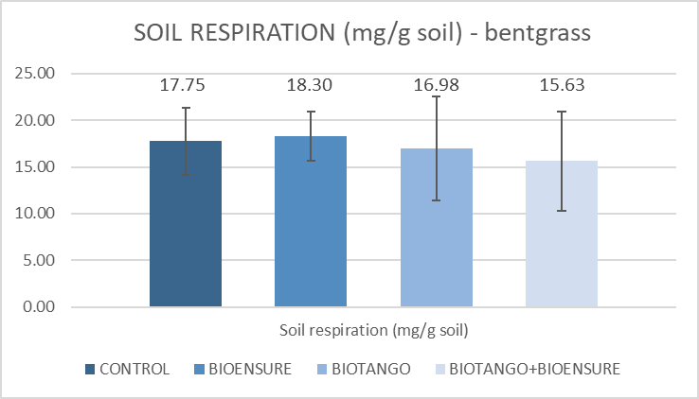
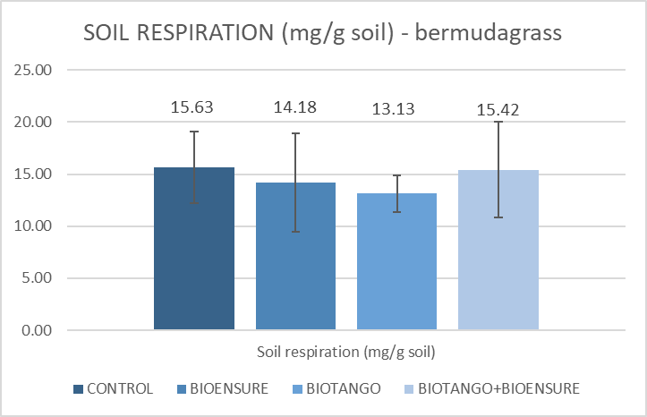
Soil Microbial Activity

Slide 12
Conclusions
2023 field studies completed; analysis ongoing
Preliminary results:
  No significant treatment impacts observed for bermudagrass drought trial
  No significant treatment impacts observed for bentgrass summer heat trial
Plants establishing for controlled environment screening. Will be completed over Winter 2023/2024

Slide 13
Thank you!
Please direct questions to djesper@uga.edu or mussieh@uga.edu

